Slide 1
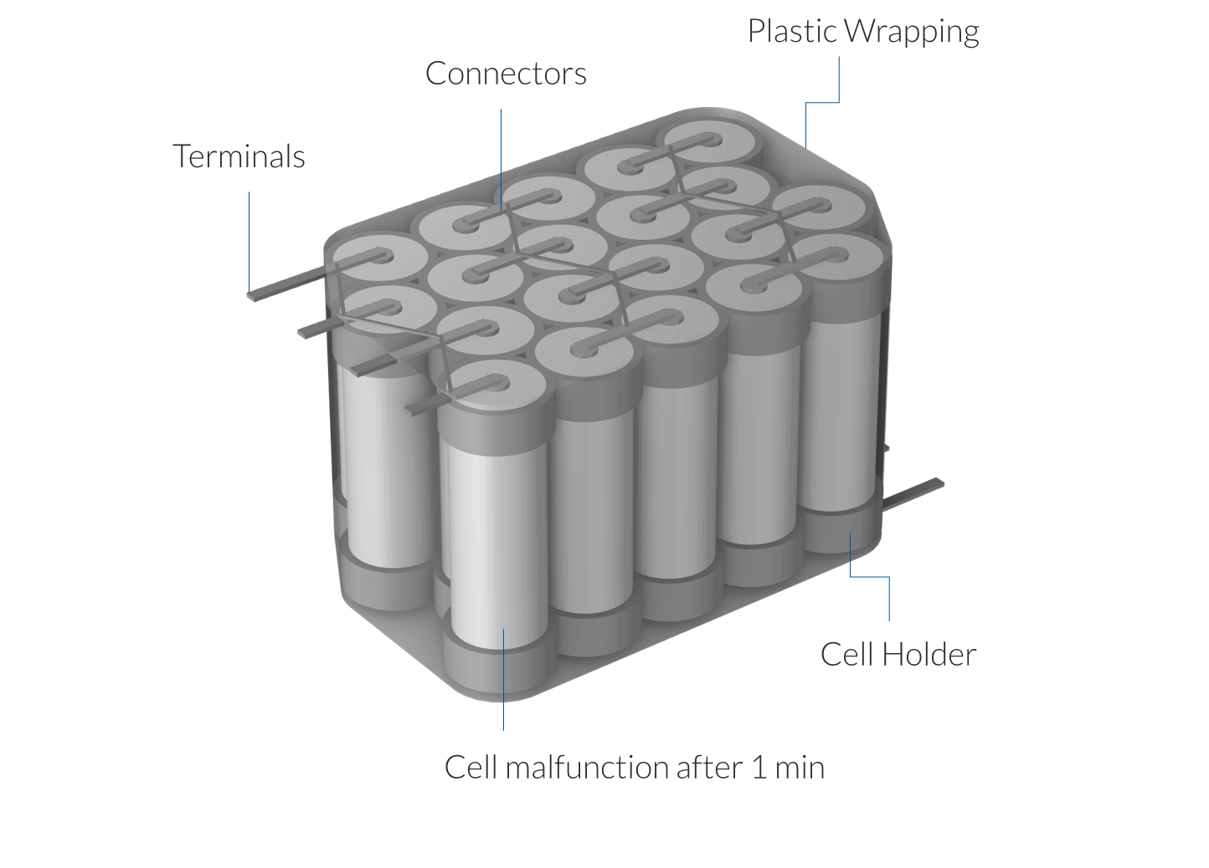
Model
Component | Material
Positive electrode | Li Mn₂ O₄
Negative electrode | Li C₆
Electrolyte | Li PF6
Positive current collector and terminal | Aluminium
Negative current collector and terminal | Copper
20 cylindrical cells, type 21700
21 mm diameter
70 mm height
5s4p configuration (5 serial strings of 4 parallel cells)
Offset packaging
Plastic holder frames
Serial and parallel connectors
Thin plastic wrapping around the entire pack
Assuming a nominal capacity of 4 Ah for each cell and nominal voltage of 3.7 V, the battery pack has a total nominal capacity of approximately 178 Wh

